Slide 1
Shoppez: A Cloud Web Application
Amrit Nimiyar-11021210080
Aayush Kumar-11021210077
Prashansa Erica Prakash-10721210001
Vanshika-10721210004
Tanya Singh-11021210066

Slide 2

HOME PAGE

Slide 3
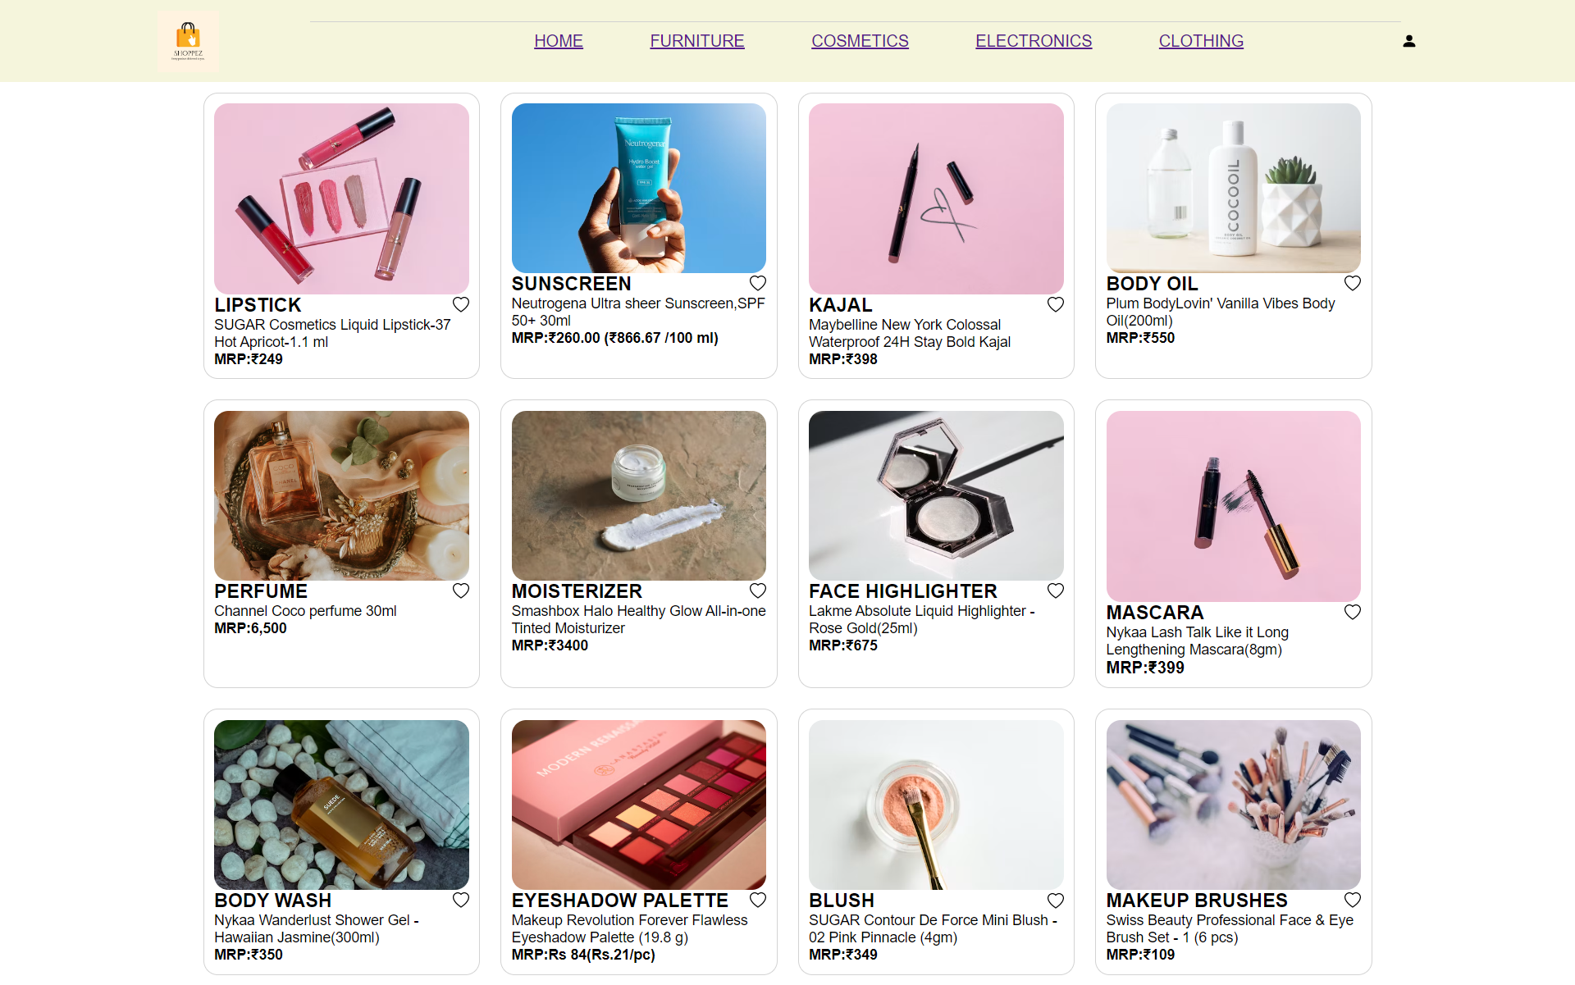
COSMETICS

Slide 4
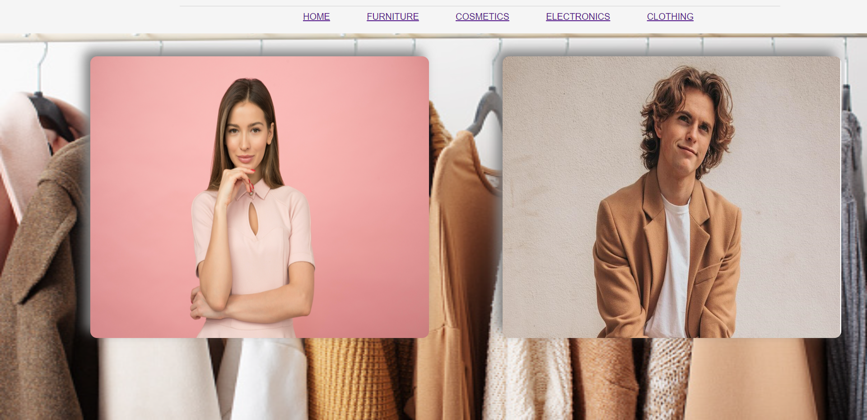
CLOTHES

Slide 5

FURNITURE

Slide 6
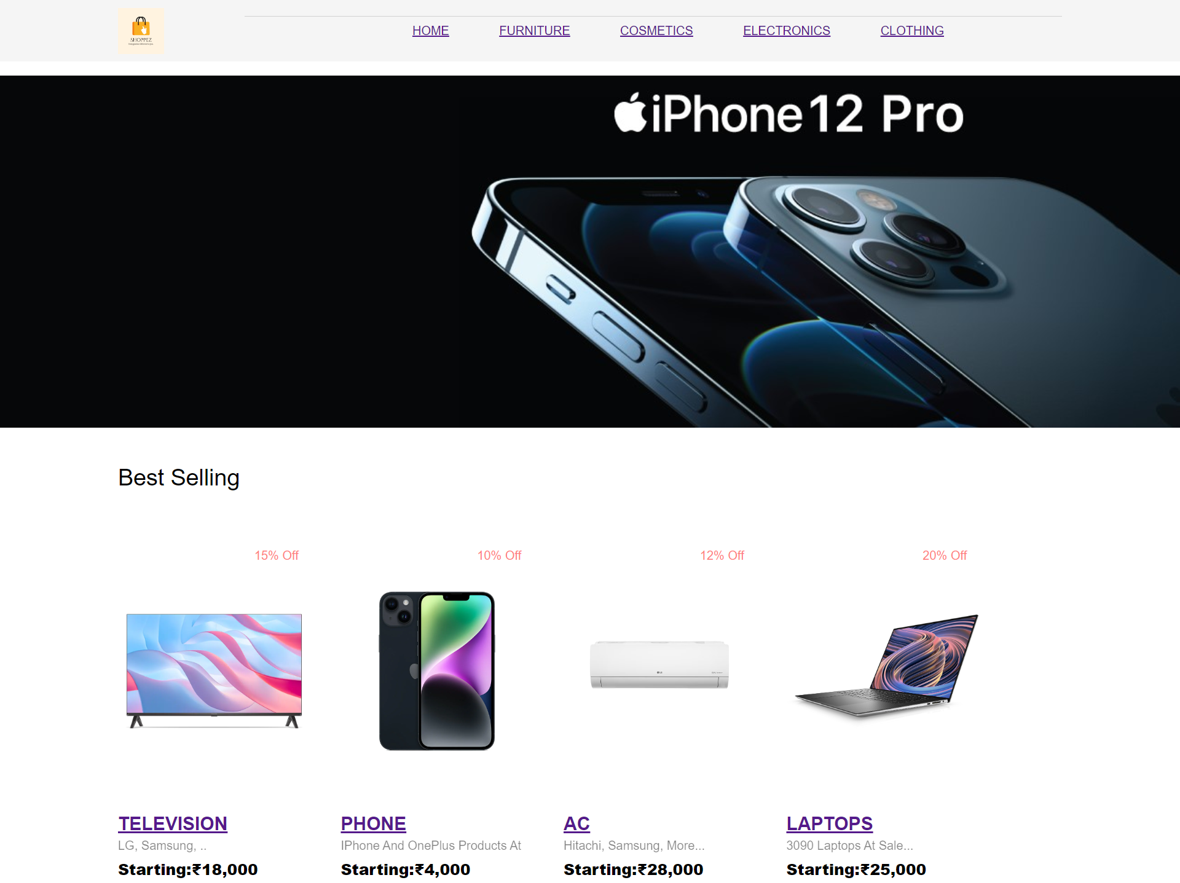
ELECTRONICS

Slide 7
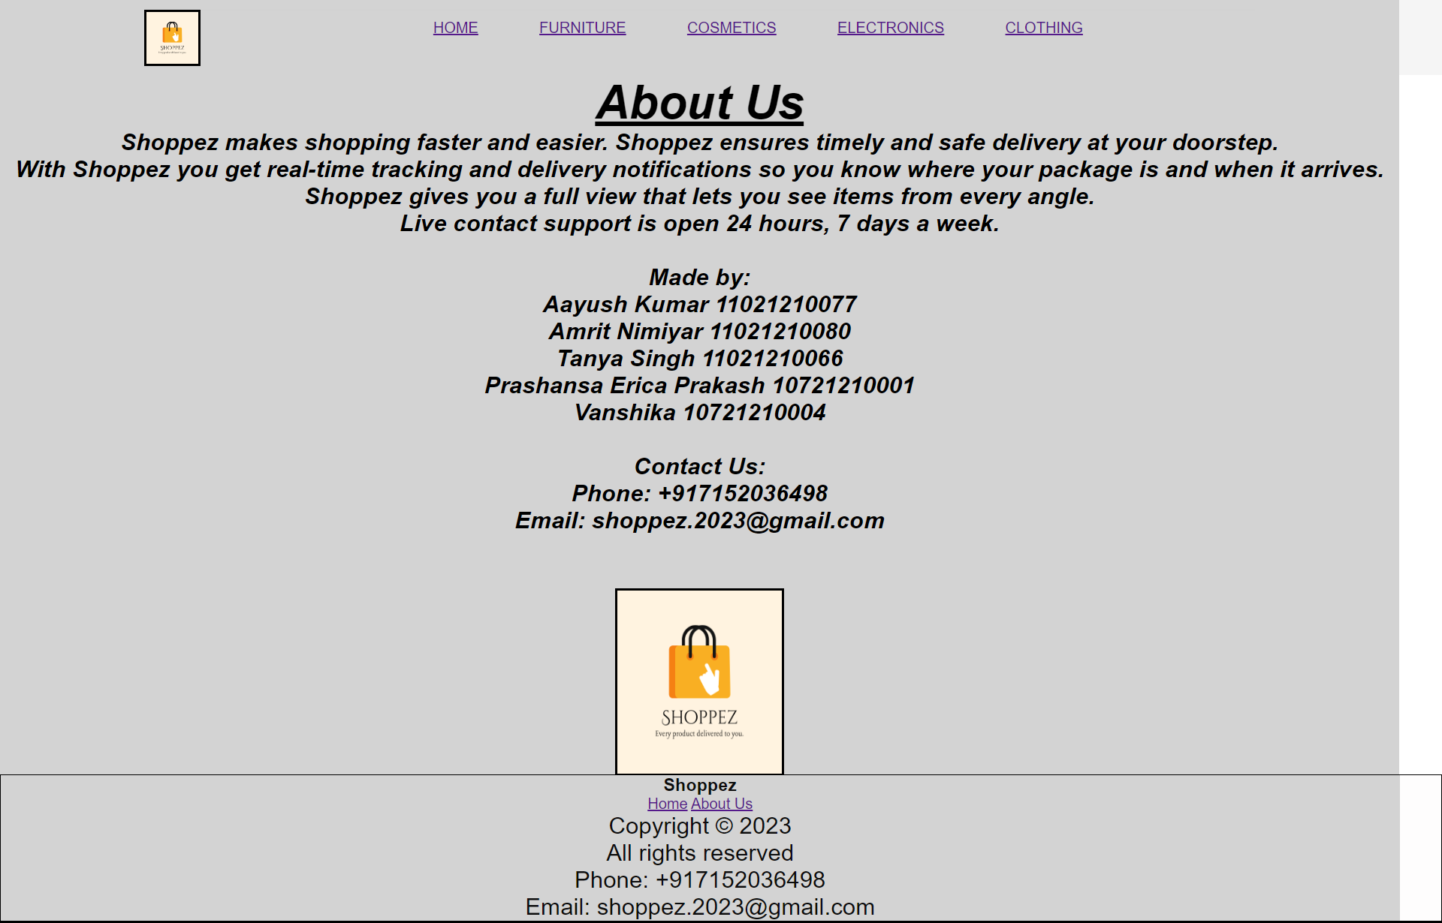
ABOUT US

Slide 8
LET’S TAKE YOU ON A TOUR OF OUR WEBSITE
C:\College\II Year\SEM IV\Cloud\Project\Cloud Project_HP.html

Slide 9
THANK YOU

